Slide 1
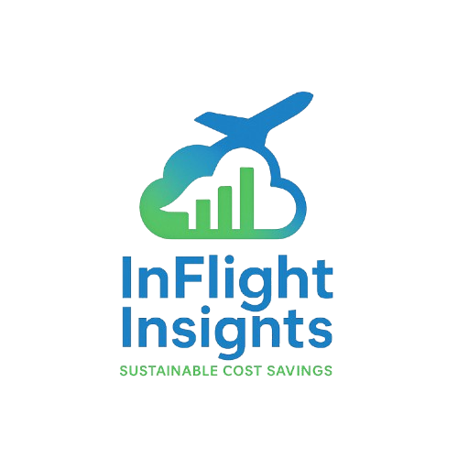


InFlight Insights
Sustainable Cost Savings
Carlos Chacon Cuesta | Rahul Sharma | Vijeth Patil

Slide 2






The Team
Carlos Chacón
Co-Founder
Mgmt of Tech MSTech
Robotics Engineering BSE
Rahul Sharma Co-Founder
IT & Security MS
Vijeth G. Patil
Co-Founder
IT & Program Mgmt MS
Philip Marzolf
New Technology Commercialization SME
Team Mentor

Slide 3

Opportunity
$8.2 Billion
Total Cost of Cabin Waste Resources & Disposal
$6.0 Billion
Specifically Untouched Food & Beverage Waste
Inflight Insights can reduce this cost by 36%

Slide 4
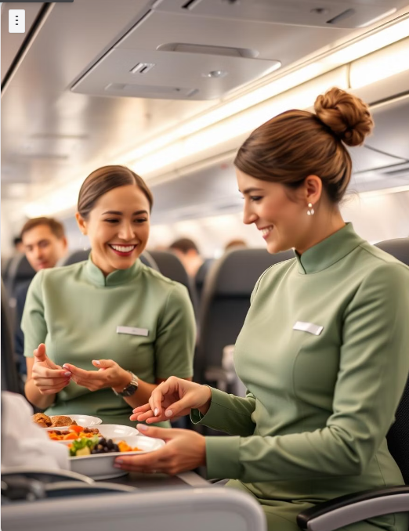
Discovery
“The key to reach the goals of sustainability is the balance between cost, man-power, and profits” – Aviation Consultant & Author
“We believe there are opportunities for reducing waste (and costs) by the salvage of unopened containers, food, and beverages.” - Food Control Consultants Ltd. 2024 Report
Airbus & Lufthansa Sky Group (2024)
Winnow (AI company) & Emirates (2020)
Lumitics & Etihad (2020)

Slide 5
Problem
No reliable method exists for airline sustainability officers to predict food preferences to prevent inventory overstocking
Reducing waste while balancing cost is a key ESG goal for many airlines
Initiatives cannot hamper flight attendant workflow or passenger satisfaction

Slide 6
Predictive Data-Driven Decision Making
1. Capture
Uneaten Food & Beverage In-Flight
2. Analyze
Identify Waste & Preferences
4. Optimize
Adjust Catering Orders
3. Predict
Forecast Consumption Trends

Slide 7





Competitive Analysis
Competitors
Features
Capture Inflight Data
Inventory & Meal Recommendations
Regional/Route Specific Meal Data
Insights for Waste Segregation S.O.P

Slide 8
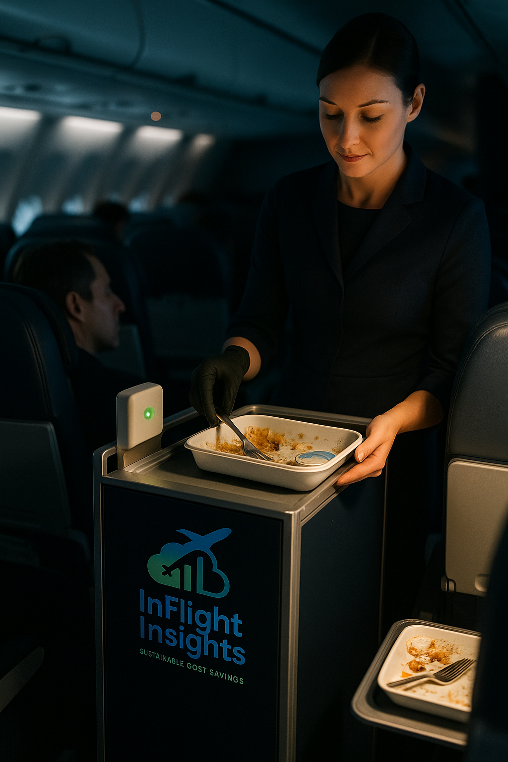




SkySense
Breakthrough imaging technology that enables high quality data-driven inventory recommendations through a web platform:
Sensor on
Trolley
Tray Scanned
Data
Analyzed
Dashboard Recommendation

Slide 9






SPAD Sensors
Emerging imaging technology with a broad range of applications…
Ultra High Sensitivity (Low Noise)
Fast Response Time
Compact & Scalable
(CMOS Compatible)
Accurate in Low Light Environments
Does NOT hamper Cabin Crew Workflow
Mobile & Cost Effective

Slide 10
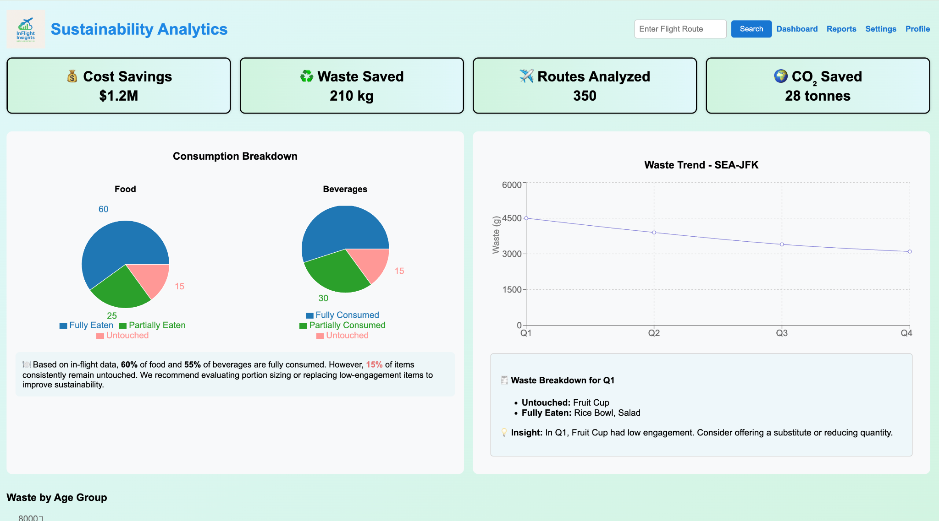
Predict & Optimize
AI Powered Meal Data Prediction Platform

Slide 11
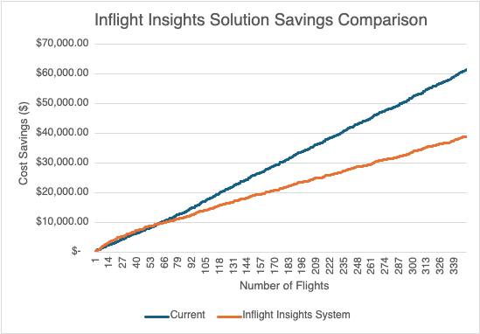
Model Validation
Monte Carlo Analysis on 350 Flights
-36.6%

Slide 12



Market Size
TAM
Untouched Food & Beverage (UF&B)
$6,000,000,000
SAM
Long Haul Flights UF&B (35%)
$2,100,000,000
SOM
Route Coverage (13%)
$280,000,000

Slide 13
Airline Benefit
$7.9k
Airline Savings
$10.5k
$2.6k
Inflight Insights’ Share
Annual Waste Averted per Trolley
Reduced
Waste
Disposal Costs
Aircraft Weight
Improved
Waste S.O.P.
Customer Satisfaction
Press & ESG Image

Slide 14
Business Model
Scalable B2B SaaS Model with Multiple Revenue Streams
Recurring
Hardware Upgrades
$
One-Time
~$300-500
Hardware Installation
Recurring
~$2,600
SaaS Data Contract

Slide 15
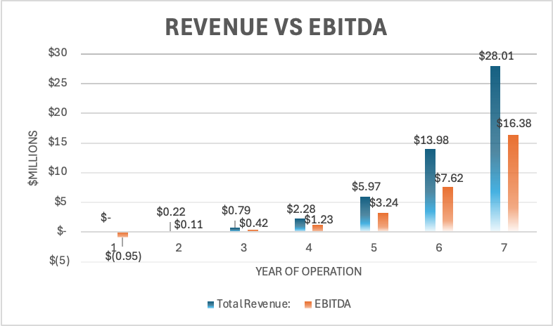
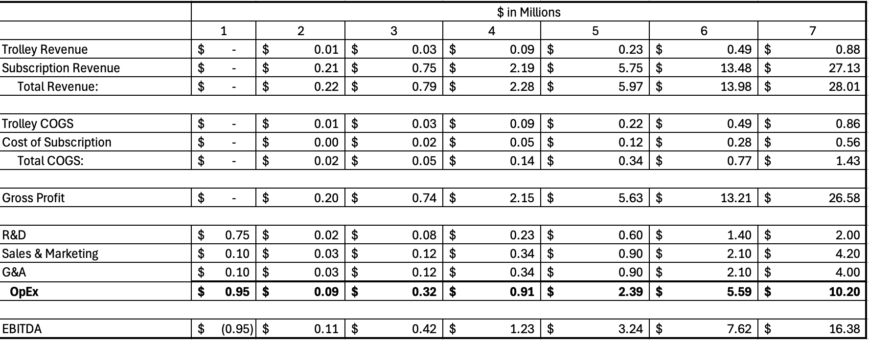
Financial Projections

Slide 16
The Ask
$1,000,000
We are looking for 12 months financing to Go-To-Market
$750K
$250K
Hardware
Prototype
Software
G&A
Sales
Marketing

Slide 17
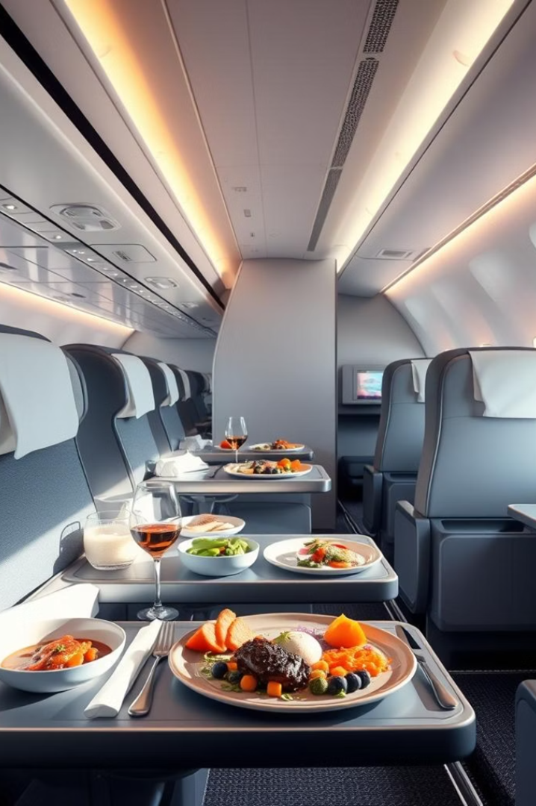
Traction & Partnerships
1
Honeywell Pilot Program
Successful MVP Development.
2
Airline Partnerships
Full Scale Deployment.
3
Catering Partnership
Data Integration.

Slide 18
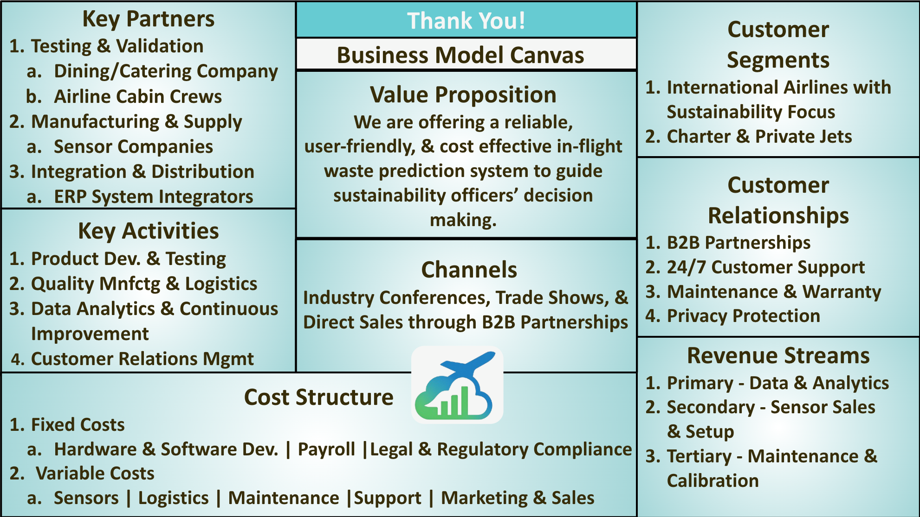

Slide 19
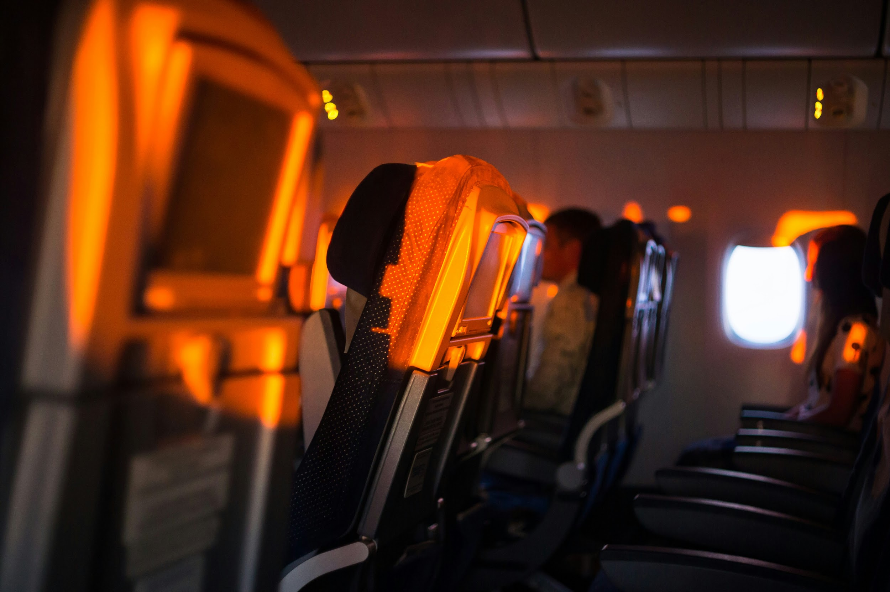
Appendices

Slide 20
Problem

Slide 21
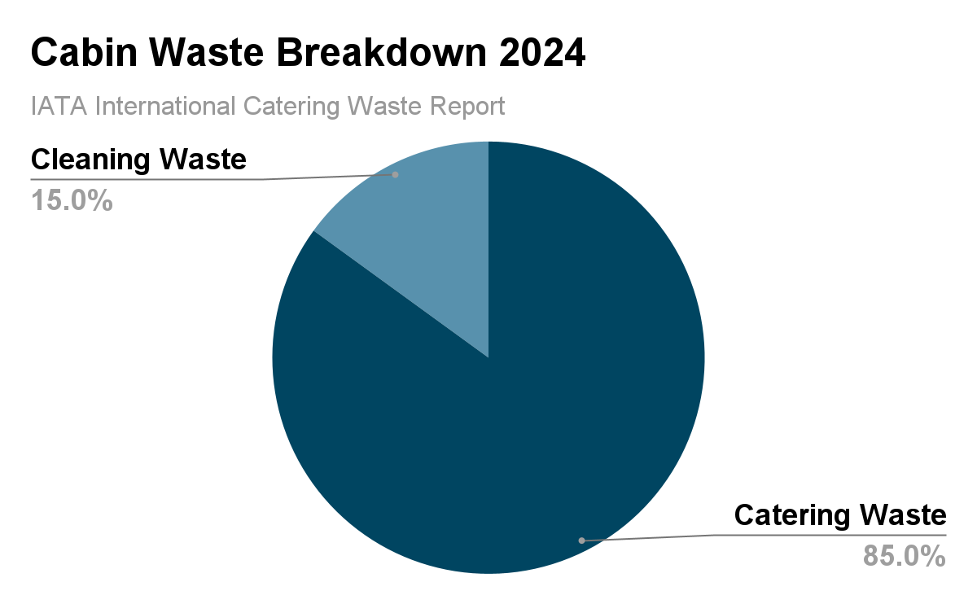
Cabin Waste
Catering waste
Inflight meals
Snacks
Beverages
Leftover Food, Drinks and Packaging
This waste can contain high volumes of liquid from unconsumed beverages and ice.
December 2024 IATA Report
34% Catering Waste - Untouched F&B
Costs $6B Resources

Slide 22
Cabin Waste Timeline
Recycling Recovery
Recovery
Disposal
Prevention
Pre Flight
During Flight
Post Flight
Most Effective
Least Effective

Slide 23

Ecosystem Map
Solutions
Indirect
Problem
Direct
Pre-Flight
Flexible Regulations
Post Flight
Airport Management
Passenger Preference Predictions
Passengers
Strict Regulations
Improved Waste Segregation S.O.P
Cabin Crew
Recycling Facilities
Pre-Flight Meal Ordering
Varying Passenger Needs
Catering
&
Cleaning
Airline Sustainability Officers
Quick Turnaround Times
City Landfills Waste Centers
Training & S.O.P Designers
In-Flight Waste
Inadequate Waste Segregation
S.O.P
Passengers
Flight Attendants
Unawareness & Counterproductive Behaviors
Pre-Flight Info Videos
Catering
&
Cleaning
Quick Turnaround Times
Flight Attendants
Better Trays
Better Trolleys
Promotions or Incentives
During
Flight
During
Flight
Improved Waste Segregation S.O.P
Better Labeling
Notes:
1. Introduction (15-20 seconds)
Set the Context: “This ecosystem map illustrates the key stakeholders involved in in-flight waste management, their pain points, and the range of solutions we explored. Our goal was to identify the most impactful solution that aligns with our sponsor’s capabilities and fills a gap in current industry practices.”
2. Direct Stakeholders Overview (15-20 seconds)
Highlight Key Players: “We engaged with four primary stakeholders:
Airline Sustainability Officers: Focused on regulatory compliance and reducing operational costs.
Flight Attendants: Concerned with time constraints and waste segregation challenges.
Passengers: Limited knowledge about waste separation and inconsistent participation.
Catering/Cleaning Contractors: Face logistical inefficiencies and waste volume challenges.”
3. Problems & Indirect Stakeholders (20-25 seconds)
Summarize Quickly: “Each stakeholder's challenges ripple across the system, impacting 2-3 indirect stakeholders. For instance:
Flight attendants’ inefficiencies impact catering and waste disposal services.
Passenger behavior influences recycling programs and airline reputations.
Sustainability officers’ constraints affect regulatory bodies and environmental organizations.”
4. Solutions Explored (20-25 seconds)
Highlight Breadth, Then Filter: “We mapped 1-4 potential solutions for each stakeholder, ranging from pre-flight prevention strategies to post-flight recovery and disposal methods. To narrow down, we evaluated solutions based on:
Alignment with our sponsor’s expertise.
Gaps in existing industry solutions identified during benchmarking.”
Final Selection & Justification (20-25 seconds)
Focus on Impactful Solution: “We filtered down to 4 solutions, but one solution emerged as the most impactful — a pre-flight prevention strategy based around in flight data acquisition. This solution not only addresses upstream waste prevention but also creates downstream efficiencies during and after the flight.
By addressing this critical point, we can positively impact waste management across the entire cabin waste timeline.”
Closing Transition (10-15 seconds)
Segue to Next Slides: “This solution forms the foundation of our competitive analysis, which demonstrates how we differentiate from existing approaches while maximizing impact on sustainability and operational efficiency.”

Slide 24
Ecosystem Map
Solutions
Indirect
Problem
Direct
Pre-Flight
Passengers
Passenger Preference Predictions
Varying Passenger Needs
Airline Sustainability Officers
Training & S.O.P Designers
Pre-Flight Meal Ordering
Cabin Crew
Notes:
1. Introduction (15-20 seconds)
Set the Context: “This ecosystem map illustrates the key stakeholders involved in in-flight waste management, their pain points, and the range of solutions we explored. Our goal was to identify the most impactful solution that aligns with our sponsor’s capabilities and fills a gap in current industry practices.”
2. Direct Stakeholders Overview (15-20 seconds)
Highlight Key Players: “We engaged with four primary stakeholders:
Airline Sustainability Officers: Focused on regulatory compliance and reducing operational costs.
Flight Attendants: Concerned with time constraints and waste segregation challenges.
Passengers: Limited knowledge about waste separation and inconsistent participation.
Catering/Cleaning Contractors: Face logistical inefficiencies and waste volume challenges.”
3. Problems & Indirect Stakeholders (20-25 seconds)
Summarize Quickly: “Each stakeholder's challenges ripple across the system, impacting 2-3 indirect stakeholders. For instance:
Flight attendants’ inefficiencies impact catering and waste disposal services.
Passenger behavior influences recycling programs and airline reputations.
Sustainability officers’ constraints affect regulatory bodies and environmental organizations.”
4. Solutions Explored (20-25 seconds)
Highlight Breadth, Then Filter: “We mapped 1-4 potential solutions for each stakeholder, ranging from pre-flight prevention strategies to post-flight recovery and disposal methods. To narrow down, we evaluated solutions based on:
Alignment with our sponsor’s expertise.
Gaps in existing industry solutions identified during benchmarking.”
Final Selection & Justification (20-25 seconds)
Focus on Impactful Solution: “We filtered down to 4 solutions, but one solution emerged as the most impactful — a pre-flight prevention strategy based around in flight data acquisition. This solution not only addresses upstream waste prevention but also creates downstream efficiencies during and after the flight.
By addressing this critical point, we can positively impact waste management across the entire cabin waste timeline.”
Closing Transition (10-15 seconds)
Segue to Next Slides: “This solution forms the foundation of our competitive analysis, which demonstrates how we differentiate from existing approaches while maximizing impact on sustainability and operational efficiency.”

Slide 25
Ecosystem Map
Solutions
Indirect
Problem
Direct
Pre-Flight
Flexible Regulations
Post Flight
Accurate & Precise In-Flight Data Acquisition
Airport Management
Passengers
Strict Regulations
Improved Waste Segregation S.O.P
Cabin Crew
Recycling Facilities
Pre-Flight Meal Ordering
Lack of In-Flight Data
Training & S.O.P Designers
Airline Sustainability Officers
Catering
&
Cleaning
Quick Turnaround Times
City Landfills Waste Centers
In-Flight Waste
Inadequate Waste Segregation
S.O.P
Passengers
Flight Attendants
Unawareness & Counterproductive Behaviors
Pre-Flight Info Videos
Catering
&
Cleaning
Quick Turnaround Times
Flight Attendants
Better Trays
Better Trolleys
Promotions or Incentives
During
Flight
During
Flight
Improved Waste Segregation S.O.P
Better Labeling
Notes:
1. Introduction (15-20 seconds)
Set the Context: “This ecosystem map illustrates the key stakeholders involved in in-flight waste management, their pain points, and the range of solutions we explored. Our goal was to identify the most impactful solution that aligns with our sponsor’s capabilities and fills a gap in current industry practices.”
2. Direct Stakeholders Overview (15-20 seconds)
Highlight Key Players: “We engaged with four primary stakeholders:
Airline Sustainability Officers: Focused on regulatory compliance and reducing operational costs.
Flight Attendants: Concerned with time constraints and waste segregation challenges.
Passengers: Limited knowledge about waste separation and inconsistent participation.
Catering/Cleaning Contractors: Face logistical inefficiencies and waste volume challenges.”
3. Problems & Indirect Stakeholders (20-25 seconds)
Summarize Quickly: “Each stakeholder's challenges ripple across the system, impacting 2-3 indirect stakeholders. For instance:
Flight attendants’ inefficiencies impact catering and waste disposal services.
Passenger behavior influences recycling programs and airline reputations.
Sustainability officers’ constraints affect regulatory bodies and environmental organizations.”
4. Solutions Explored (20-25 seconds)
Highlight Breadth, Then Filter: “We mapped 1-4 potential solutions for each stakeholder, ranging from pre-flight prevention strategies to post-flight recovery and disposal methods. To narrow down, we evaluated solutions based on:
Alignment with our sponsor’s expertise.
Gaps in existing industry solutions identified during benchmarking.”
Final Selection & Justification (20-25 seconds)
Focus on Impactful Solution: “We filtered down to 4 solutions, but one solution emerged as the most impactful — a pre-flight prevention strategy based around in flight data acquisition. This solution not only addresses upstream waste prevention but also creates downstream efficiencies during and after the flight.
By addressing this critical point, we can positively impact waste management across the entire cabin waste timeline.”
Closing Transition (10-15 seconds)
Segue to Next Slides: “This solution forms the foundation of our competitive analysis, which demonstrates how we differentiate from existing approaches while maximizing impact on sustainability and operational efficiency.”

Slide 26
Customer Discovery

Slide 27
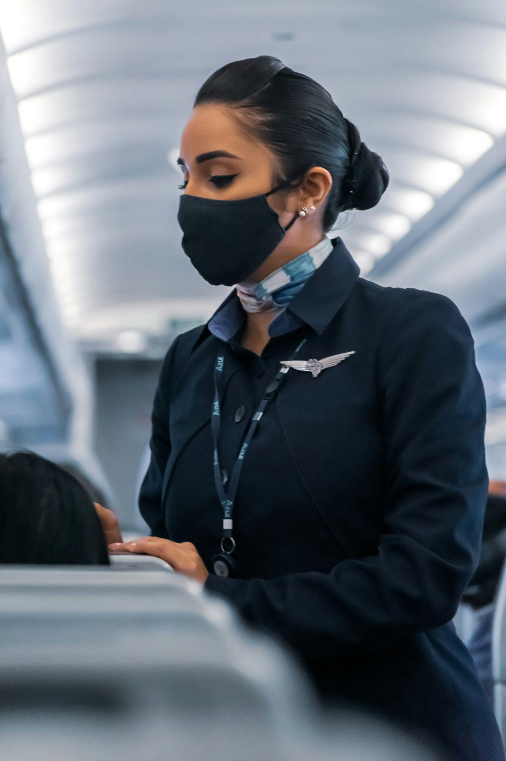
Key Stakeholders
Procurement Officials/Supply Chain
Cabin Crew (i.e Flight Attendants)
Corporate communications/Marketing
Customer services/Customer relations
Catering Contractors
Cleaning Contractors
Redistribution Charity Partners
Regulators/Food Safety Experts
Inflight product suppliers
Cabin interior designers/manufacturers

Slide 28
Customer Discovery
Research
Design Qs
Interviews
Compile Insights
-IATA Reports
-Airline ESG Reports
-Regulation Info
-Question & Interview Design
-Identify Personas & Stakeholders
-Reachout to Stakeholders
-Conduct Interviews
-Compare Findings
-Identify Relevant Insights

Slide 29
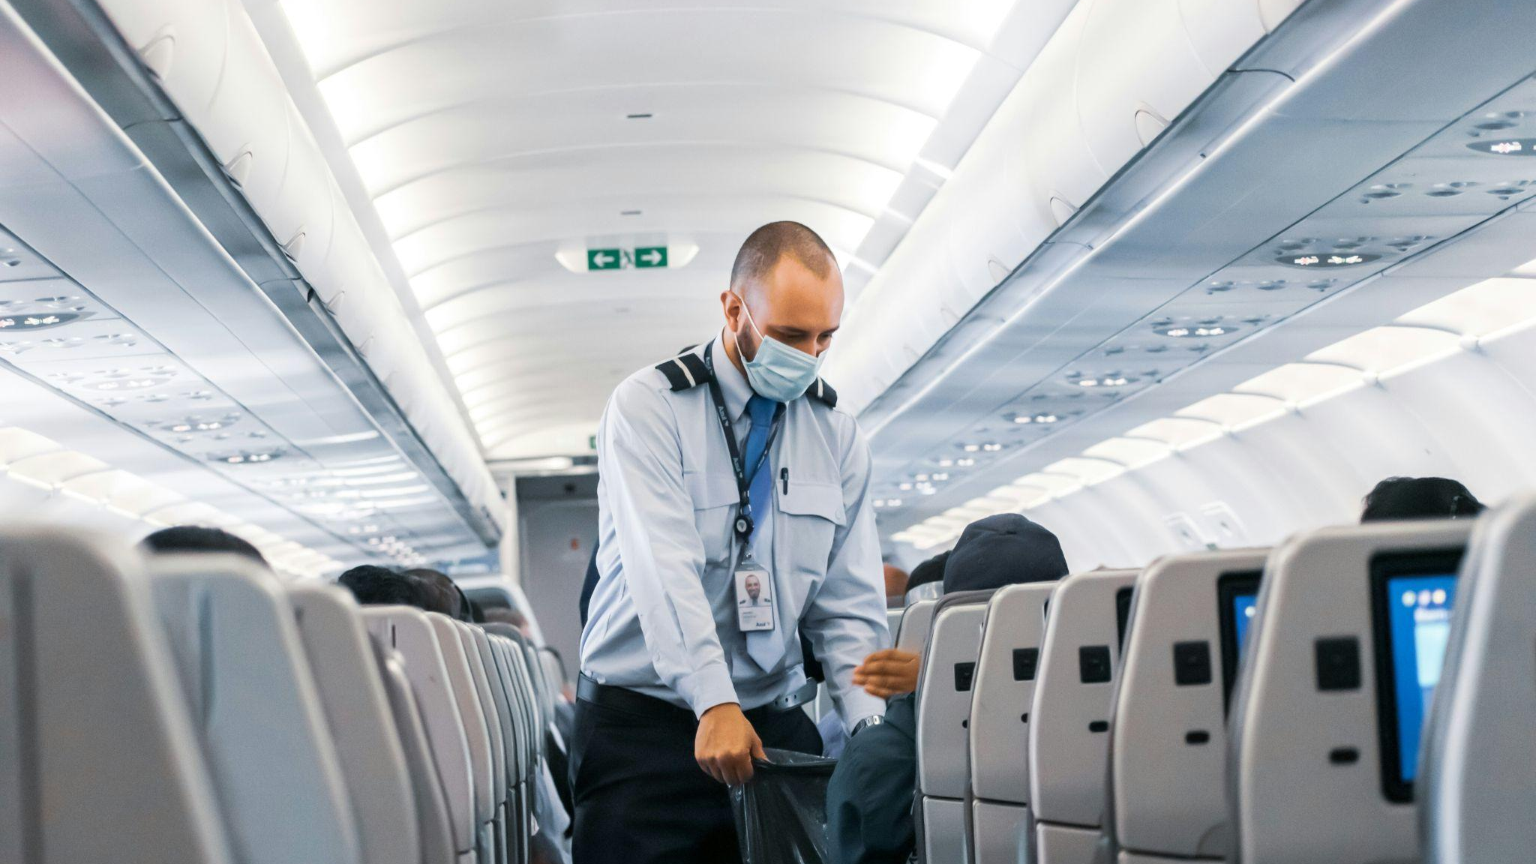

Most flight attendants don't even think about recycling…from the attendant’s perspective, we do not have the manpower or time to recycle”
– Deborah Penderghast American Airlines Lead Flight Attendant
Untouched and leftover foods are one of the major sources of waste on a flight ”
– Shadrach Kambai Aviation Consultant and Author

Slide 30
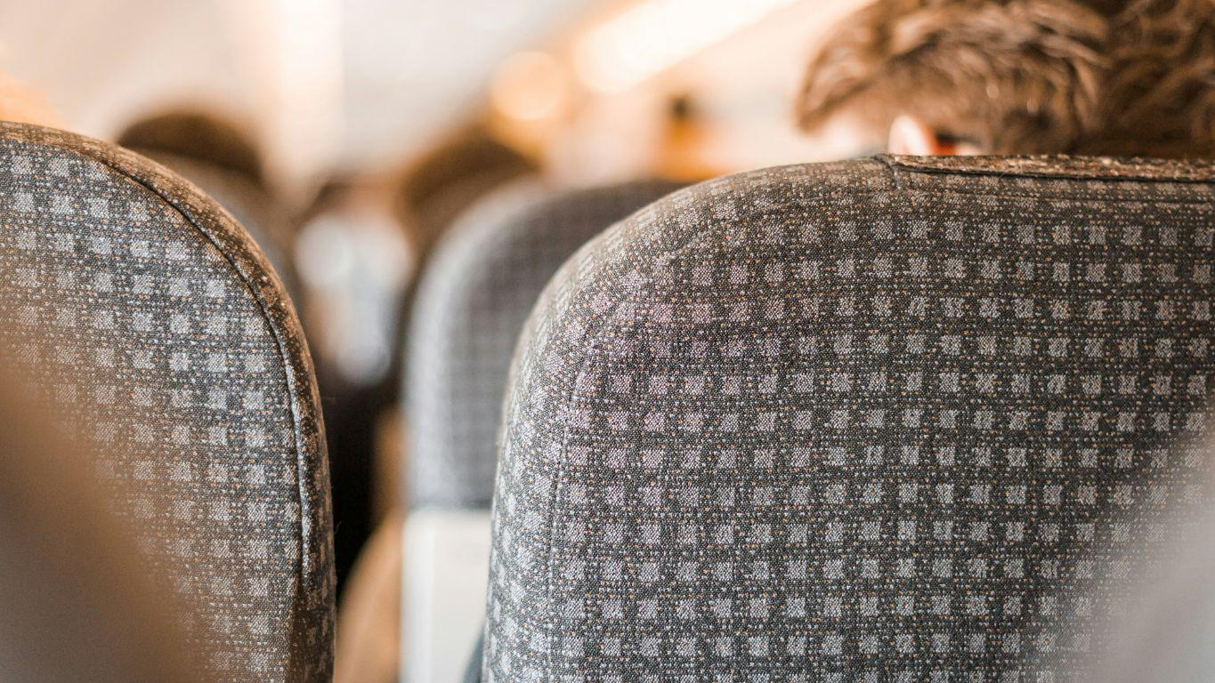

There are simple solutions [to improve waste management] but if they are not profitable for the airlines, they do not implement them. The question is at what point do price and sustainability equate?”
– David Altmark Delta Customer Service Agent
The key to reach the goals of sustainability is the balance between cost, man-power, and profits”
– Shadrach Kambai Aviation Consultant and Author

Slide 31
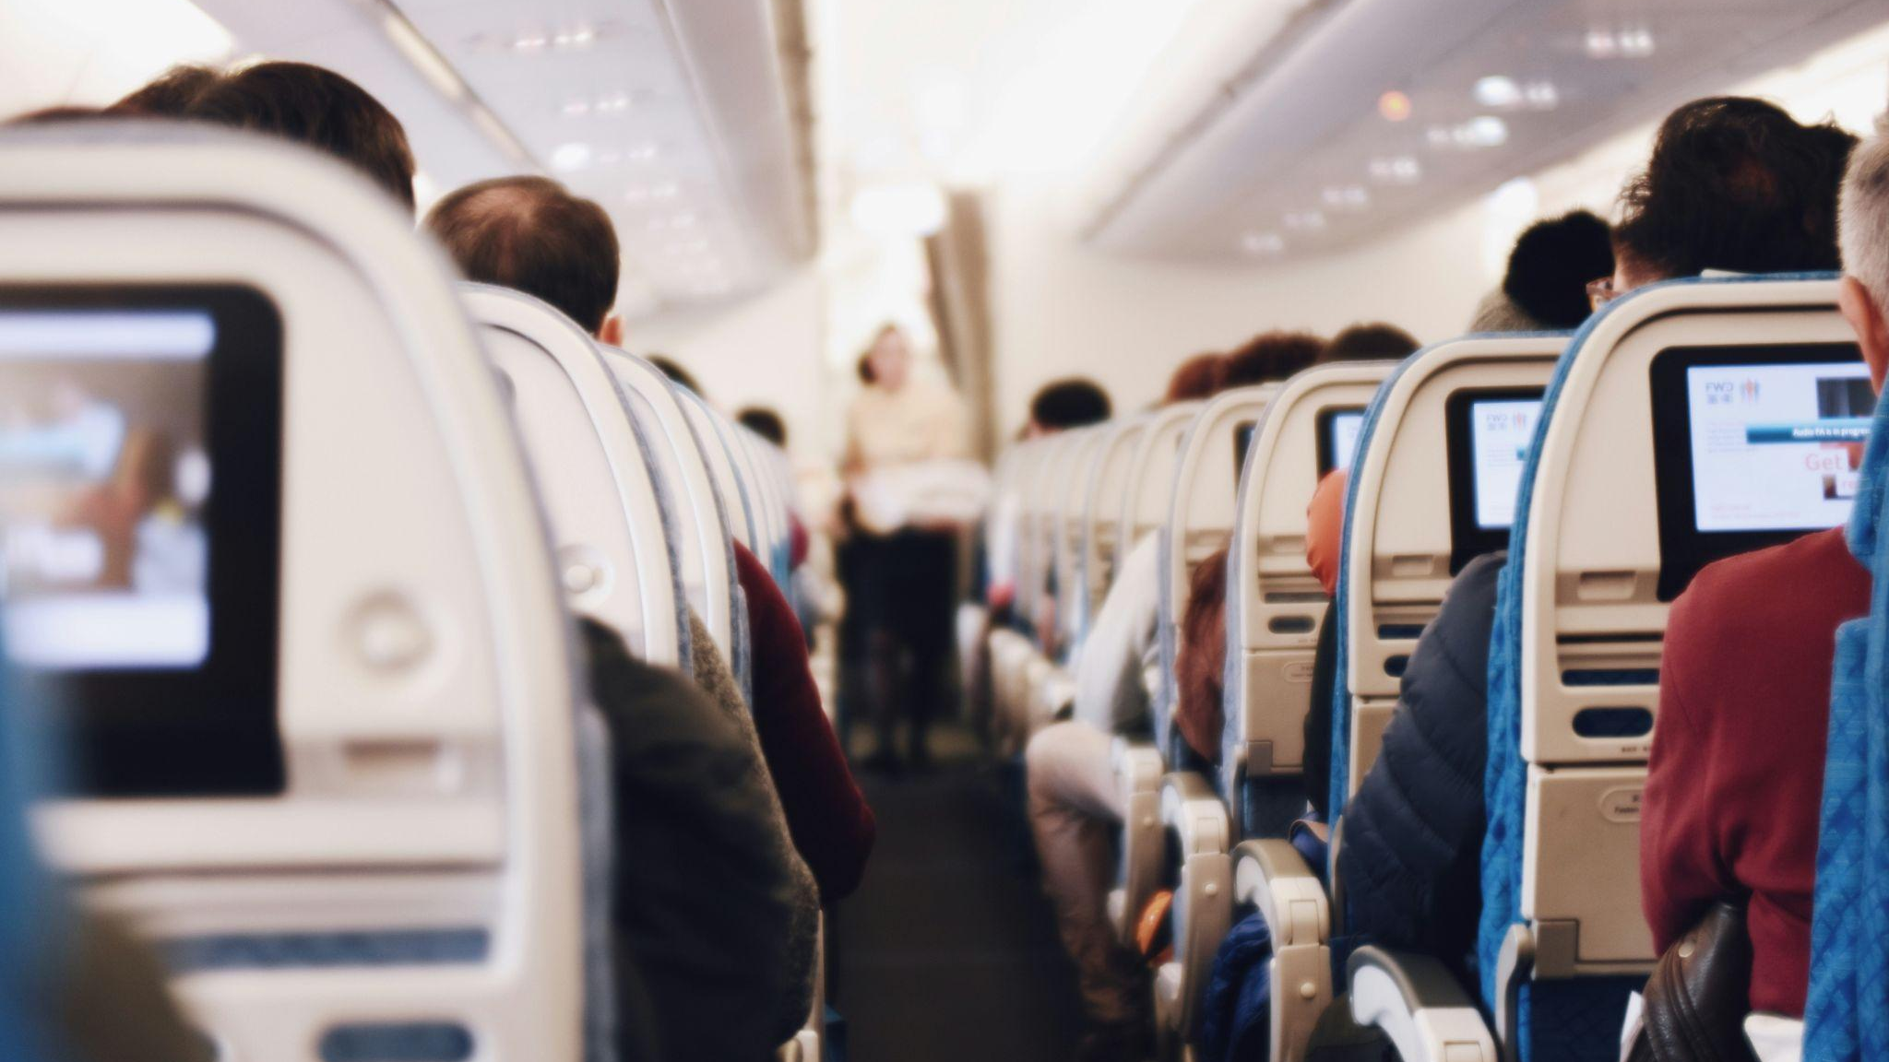
I honestly don’t consider waste at all, especially because it usually is not a lot and because I’m busy thinking about other things when flying.”
– Benjamin Pham Delta Coordinator & Frequent Flier
I often wonder how much waste we generate during a single flight. I want to believe that by making small changes—like reusing items or sorting my trash—I’m contributing to a more sustainable journey.
– Abishek Aryal Frequent Flier/Passenger

Slide 32
Financials

Slide 33
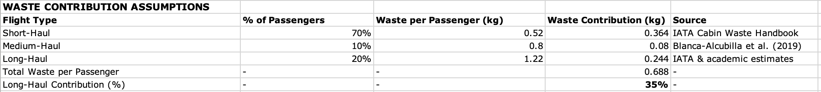
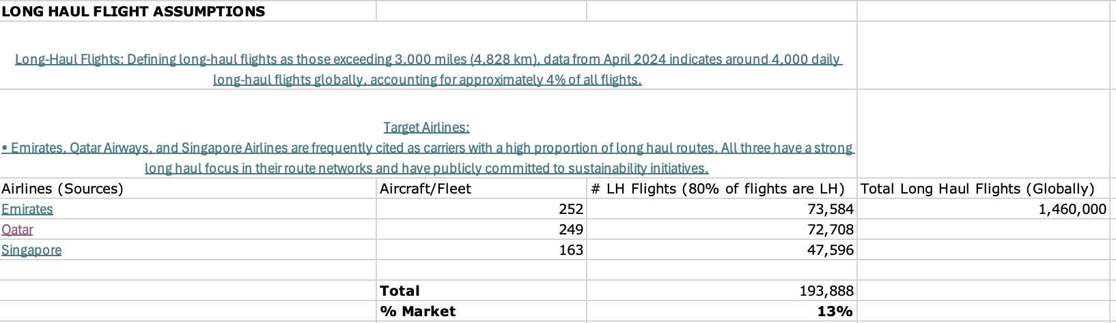
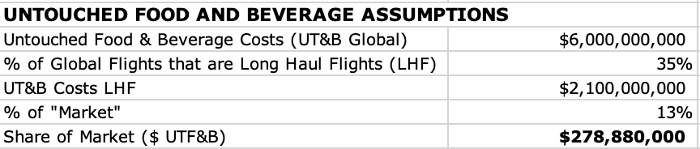
Market Size Assumptions

Slide 34
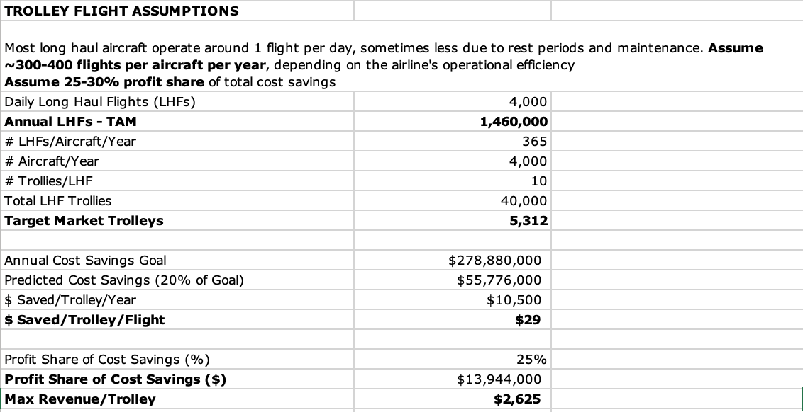
Trolley Assumptions

Slide 35
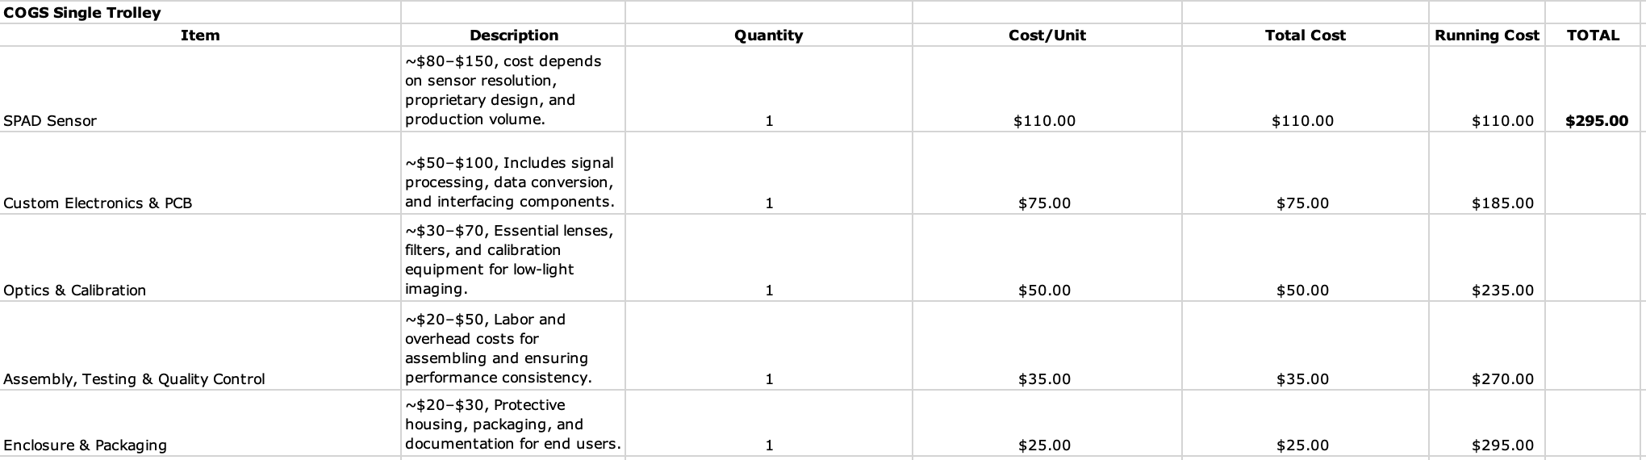
COGS for Sensor System

Slide 36
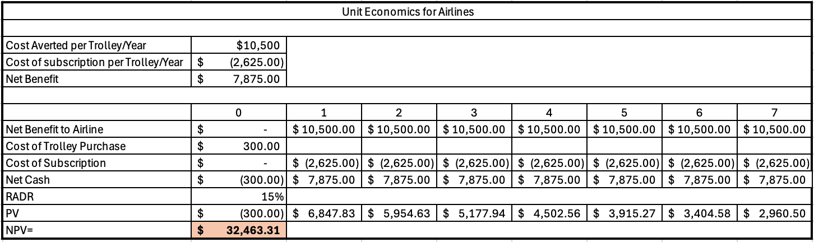
Unit Economics

Slide 37
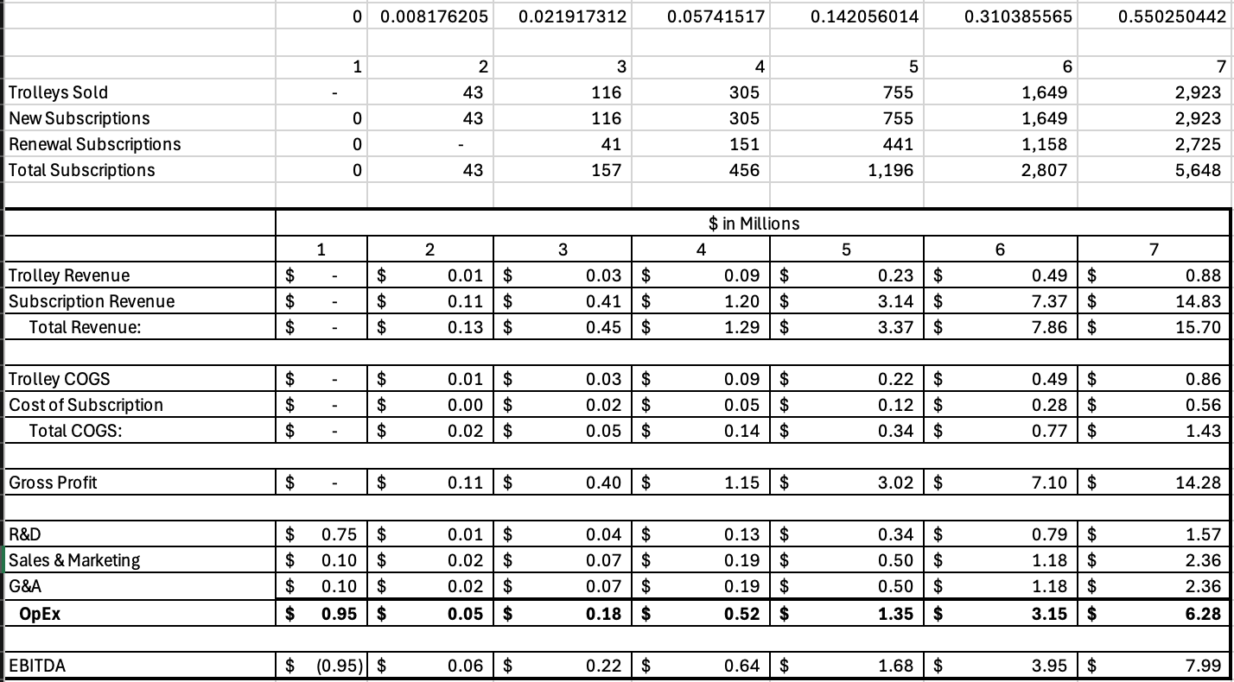
Profit & Loss

Slide 38
Calculations

Slide 39
Waste Calculations
📌 Handling & Disposal Cost:
💰 $600 per tonne (US)
📌 Passenger Traffic (2023):
🛫 US: 862.8 million passengers
🌍 Global: 4.5 billion passengers
📌 Waste Generation (2023):
♻️ Per Passenger: 0.94 kg (2 lbs)
🚛 US Total: 783,000 tonnes (~1.7 billion lbs)
Equivalent to 260,000 elephants 🐘 or 522,000 cars 🚗
🌎 Global Total: *3.6 million tonnes
Equivalent to 1.36 million elephants 🐘 or 2.7 million cars 🚗
📌 Disposal Costs (2023):
🇺🇸 US: $470 million
🌎 Global: **$2.16 billion
*IATA’s 3.6 million tonnes figure accounts for haul length variations in waste production.
** Assuming $600 per tonne for global handling/disposal as well

Slide 40
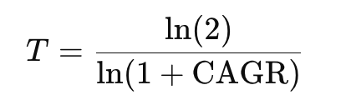
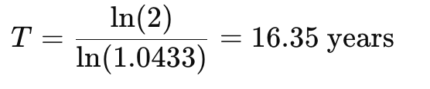
CAGR Calculations
📌 Annual Growth Rate (CAGR 2025–2029): 4.33% ✈️
📌 Doubling Time Calculation:
🧮 Formula:
🔢 Substituting values:
📌 Projected Doubling Year:
📅 2025 + 16.35 ≈ 2041
📌 Impact on Cabin Waste:
If passenger traffic and cabin waste generation grow proportionally, the amount of in-flight waste will also double by 2041 unless reduction strategies are implemented. ♻️🚮

Slide 41
Research

Slide 42
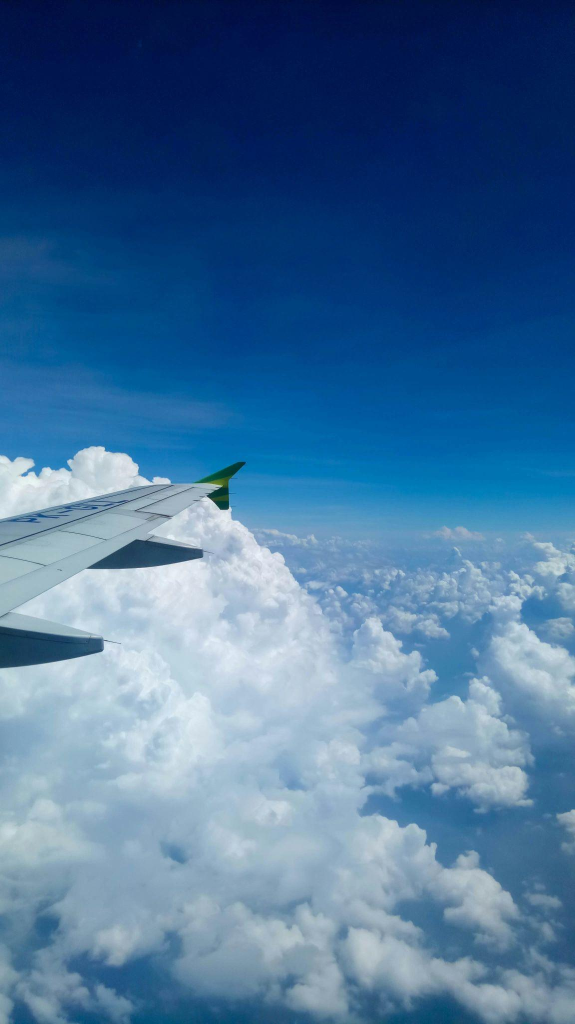
Research
Key Findings
2 Primary Cabin Waste Streams
Cleaning & Catering (Galley) Waste
Commonly handled by Cleaning Contractor and the Catering Contractor
Waste Type, Quantity, & Regulations Depend on Flight
Department of Agriculture (USDA)
Animal and Plant Health Inspection Service (APHIS)

Slide 43
Research (Cont.)
Key Findings
Separation of the waste-streams needs to happen on the aircraft before the collected material reaches a catering or materials handling facility.
Segregation of waste is not common or widespread through the sector
Sent to incineration or landfill solutions when they could be prevented, reused or recycled.
Reasons
Time – both cabin crew and cleaning staff are time constrained with little spare capacity to undertake additional tasks that would extend their duties.
Costs of waste handling and disposal are frequently not specified within catering and cleaning contracts so there are few incentives for airline staff procuring those services to question waste treatment costs or to put measures in place to reduce them.
Airlines are more conscious of customer service, quality and branding than cabin waste management.
Perception of risk and the need for regulatory compliance may mean that airlines, catering and cleaning companies take a precautionary stance when handling cabin waste.

Slide 44
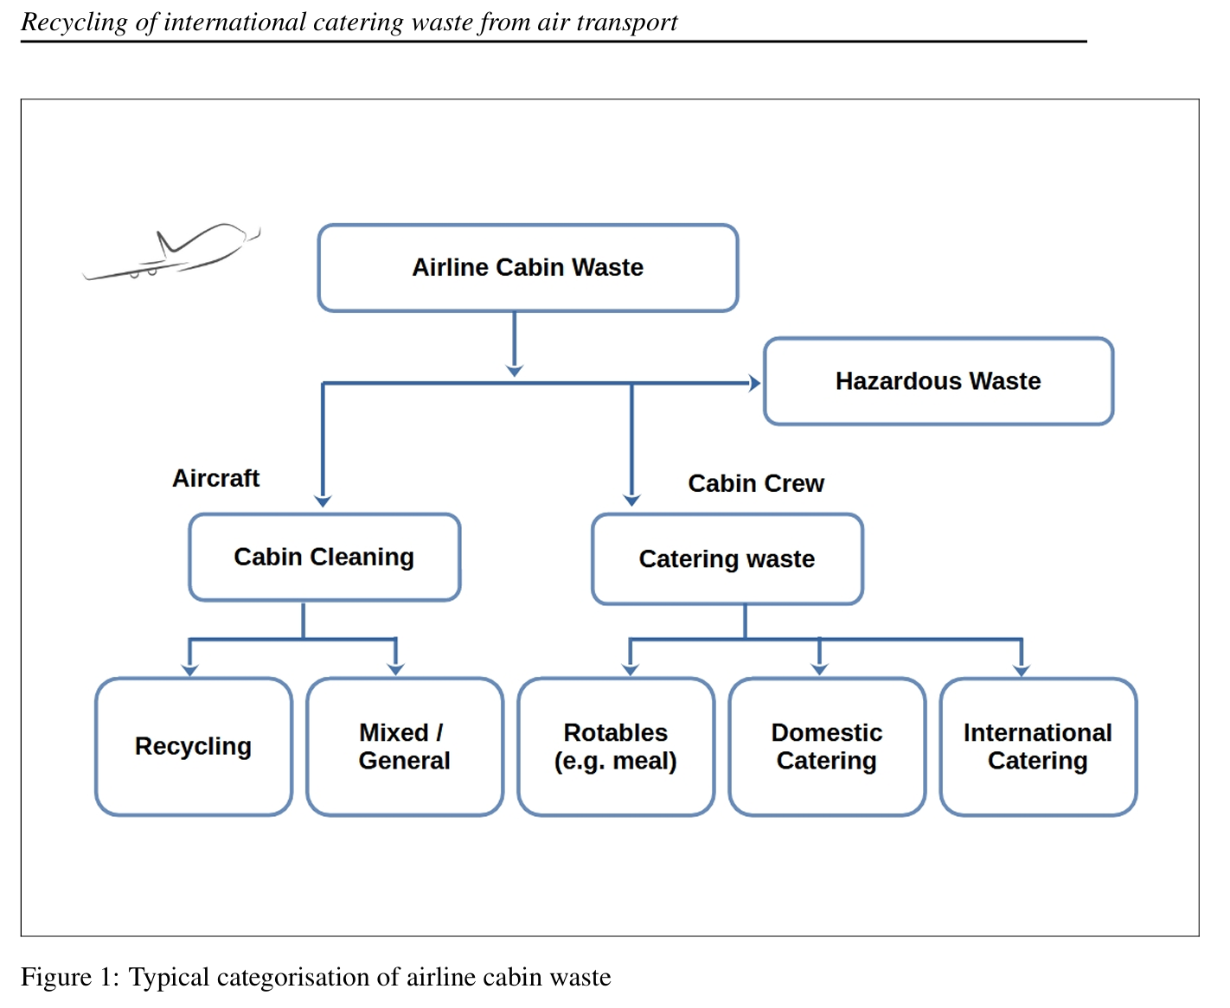
Source: International Catering Waste: A Case for Smarter Regulation (2024).

Slide 45
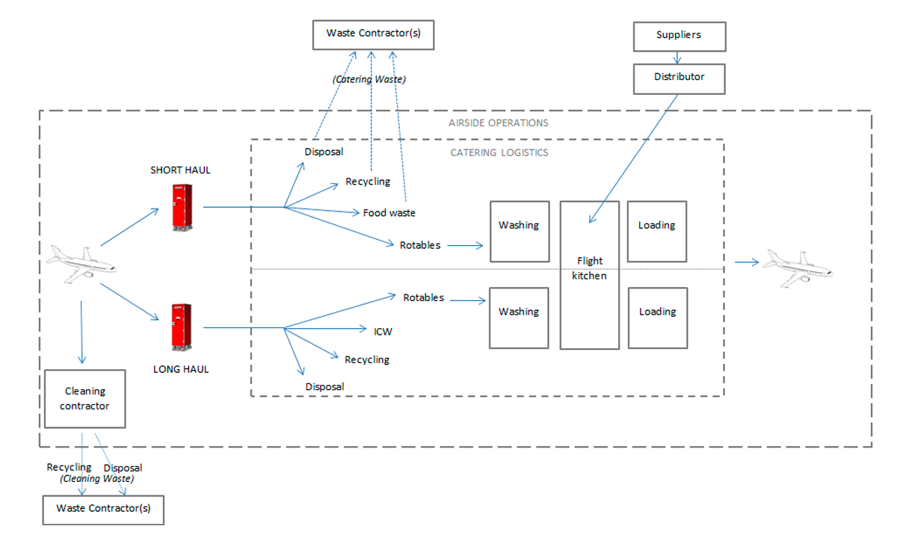
Source: International Air Transport Association Cabin Waste Handbook 2017.
Notes:
Cooked meals are usually served to passengers on long haul (> 6 hour) flights while sandwiches or similar are served on short haul flights.
Source: International Catering Waste: A Case for Smarter Regulation (2024).

Slide 46
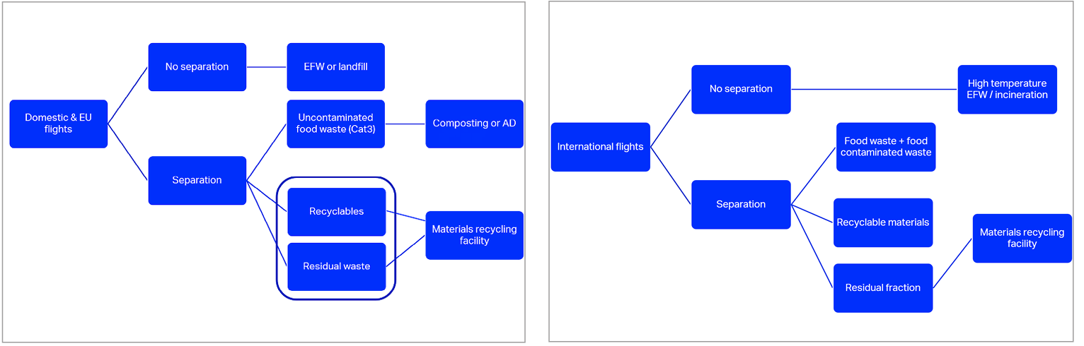
Source: International Air Transport Association Cabin Waste Handbook 2017.
Notes:
NOTE: The vertical gold bar should remain the same height as the white text box area.
Photos can be replaced to support your presentation.
Find additional images to use for this slide

Slide 47
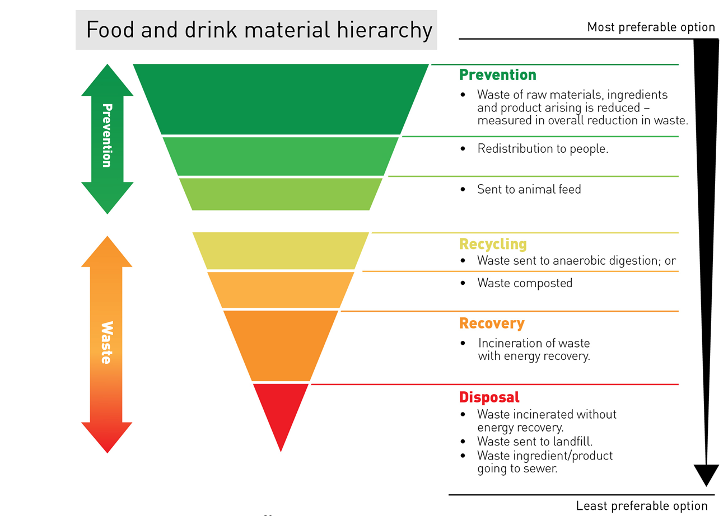
Source: International Air Transport Association Cabin Waste Handbook 2017.

Slide 48
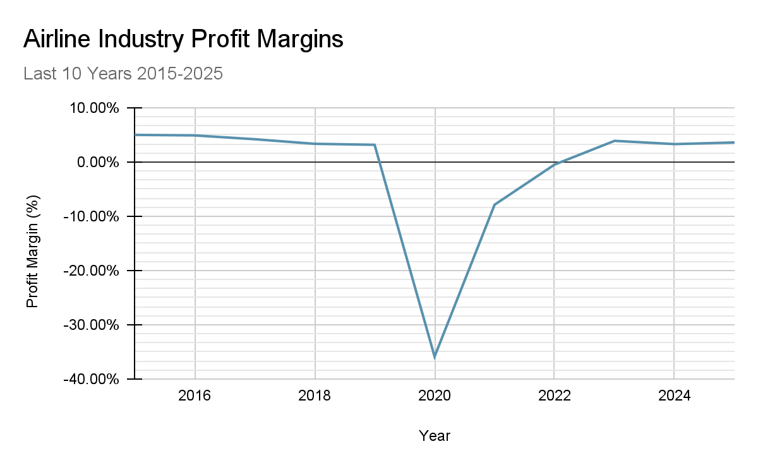
Cost-Savings

Slide 49
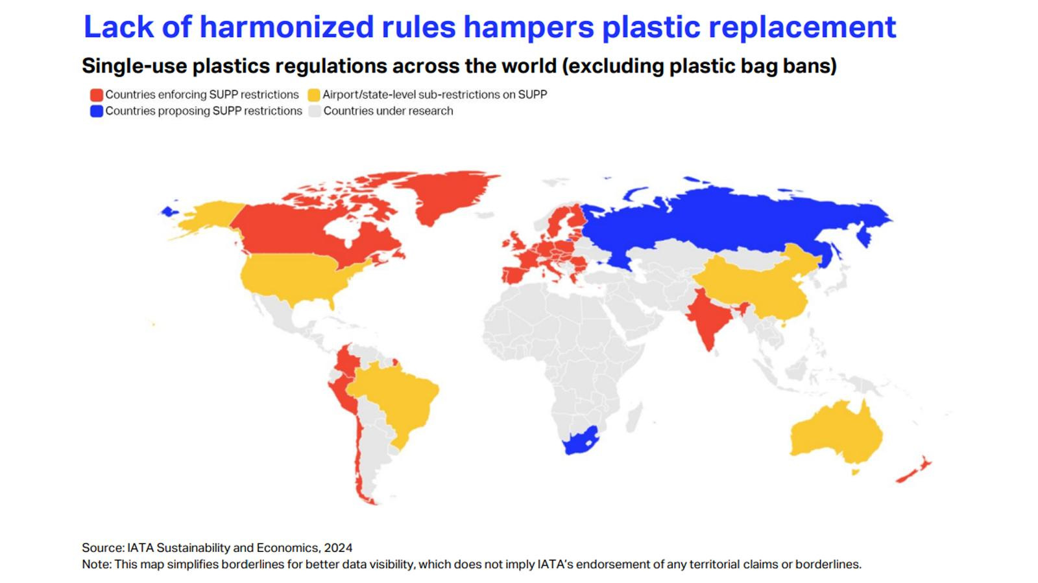
Regulations

Slide 50
Competition
Current Initiatives
Reducing use of paper on-board (Prevention) - Swiss, KLM
Reinjection of edible food in subsequent flights (Reuse) - New Zealand Air
Redistribution of unconsumed and edible food and drink through donation (Reuse) - Cathay Pacific, Qantas, European Union, WRAP (UK)
Pre-flight Meal Ordering (Prevention/Recycling) - Singapore Air, Qantas, Ryanair, Air Baltic
Develop standard operating procedures (SOP) for segregation of waste within the cabin (Reuse) - IATA, KLM, Iberia, Delta Airlines
Provision of recycling trolley carts that allow for in-flight separation of recyclables and waste (Recycling) - Airbus, KLM
Aircraft cabin design should incorporate the need to handle and manage cabin waste correctly (Reduction/Recycling) - Airbus, Iberia
Agree and promote a clear and consistent sectoral colour coding and labelling system for cabin waste and recycling bags, containers and trolley compartments (Recycling) - IATA, Easy Jet

Slide 51
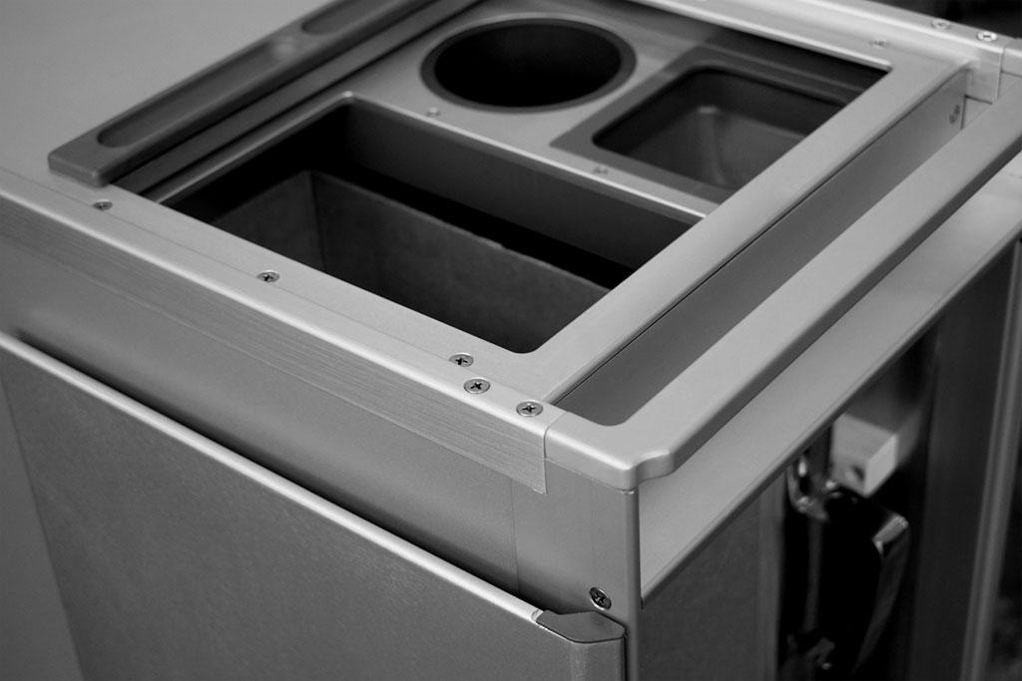

Promising Ideas
New Trolley Systems
Ex: Airbus & KLM
Pre-flight Meal Ordering
Ex: Qantas, Baltic Air, Singapore Airlines, Emirates

